Slide 1

EC-101 Basics of Electronics & Communication Engineering
Module-5
By
Dr. Priyank Saxena
Assistant Professor

Slide 2
Course Syllabus
Module-3 : Sinusoidal Oscillators Sinusoidal Oscillators: Concept of positive and negative feedback, Barkhausen criterion for sustained oscillations, Determination of Frequency and Condition of oscillation, Hartley and Colpitt’s oscillator. Operational Amplifiers: Operational Amplifiers: Characteristics of an Ideal and Practical Operational Amplifier (IC 741), Inverting and non-inverting amplifiers, Offset error voltages and currents; Power supply rejection ratio, Slew Rate and concept of Virtual Ground, Summing and Difference Amplifiers, Differentiator and Integrator, RC phase shift oscillator. {8 Lect. hours}
Module-4 : Logic Gates and Boolean Algebra Logic Gates and Boolean algebra: Introduction to Boolean Algebra and Boolean operators, Symbolic representation, Boolean algebraic function and Truth table of different Digital logic Gates (AND, OR, NOT, NAND, NOR, EX- OR, EX-NOR); Realization of Basic logic gates using universal gates, Adder, Subtractor, adder/subtractor. {8 Lect. hours}

Slide 3

Introduction To Communication
Module – V
Vol. No.-1
What is Communication?
“Communication is the process of establishing connection or link between two points for the information exchange”.
“Communication is the science of transmitting, receiving, and processing of information”.
“Communication is the process of exchanging information”. “Main barriers are language and distance”
Contemporary society’s emphasis is now the accumulation, packaging, and exchange of information.

Slide 4



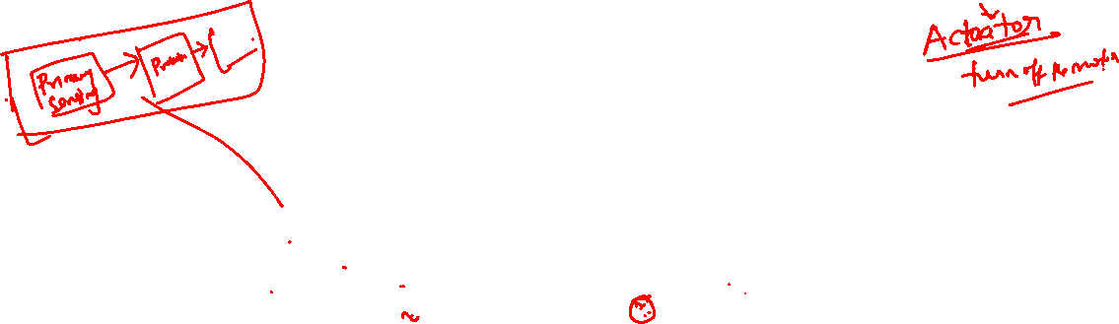
Introduction To Communication contd.
Module – V Vol. No.-1
Communication System:
Input
Signal
Output Signal
Source
Destination
Input Transducer
Communication System
Output Transducer
Fig.5.1.1 [Communication System with input & output transducers]

Slide 5

Introduction To Communication contd.
Input Transducer:
The message produced by a source must be converted by a transducer to a form suitable for the particular type of communication system.
Example: In electrical communications, speech waves are
converted by a microphone to voltage variation.
Output Transducer:
Converts the electric signal at its input into the form desired by the system user.
Example: Loudspeaker, personal computer (PC), tape-
recorders.

Slide 6






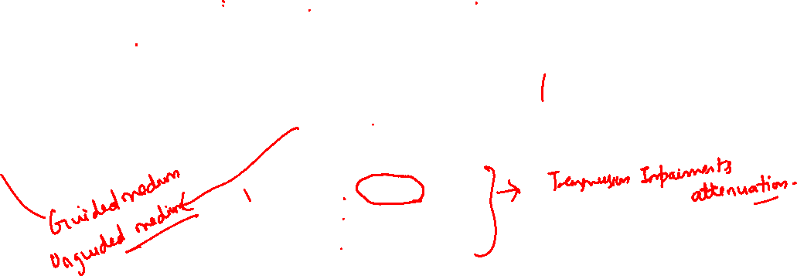
Introduction To Communication contd.
Module – V Vol. No.-1
Elements of Communication System:
Message Signal
Estimate of message Signal
Communication system
Information Source
&
Input Transducer
Transmitter
Receiver
Output Transducer &
Information Sink
Communication Channel
Transmitted
Signal
Received Signal
Noise, Interference, and Distortion
Fig.5.1.2 [Elements of a Communication System]

Slide 7

Introduction To Communication contd.
Module – V Vol. No.-1
Information Source:
It generates a message which may be of the form of voice, picture or
plain text or any data.
The transducer converts the output of a source into an electrical signal and vice-versa.
Information Sink:
It stores the estimate of message signal in some appropriate form.
Irrespective of the form of communication process being considered, there are three basic elements to every communication system, namely:
Transmitter
Channel
Receiver
(Also called Heart of any communication system)

Slide 8

Introduction To Communication contd.
Module – V Vol. No.-1
Transmitter:
The transmitter processes the input signal to produce a signal suits to the characteristics of the transmission channel.
Signal processing for transmission almost always involves modulation
and may also include coding.
In addition to modulation, other functions performed by the transmitter are amplification, filtering and coupling the modulated signal to the channel.
Communication Channel:
The communication channel provides a means of carrying electrical or electromagnetic signals between a transmitter and a receiver.
Depending upon the physical implementation, channels can be
classified as:
Guided Propagation Channels
Free propagation Channels.

Slide 9

Introduction To Communication contd.
Module – V Vol. No.-1
Guided Propagation Channels: includes telephone channels, coaxial cables, and optical fibers.
Free propagation Channels: includes wireless broadcast channels, mobile radio channels, and satellite channels.
Receiver:
The receiver’s function is to extract the desired signal from the received signal at the channel output and to convert it to a form suitable for the output transducer.
Other functions performed by the receiver: amplification (the received signal may be extremely weak), demodulation and filtering.

Slide 10
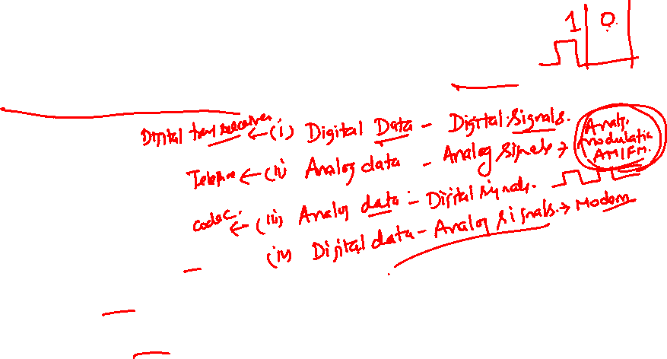
Introduction To Communication contd.
Transceivers: is an electronic unit that incorporates circuits that both send and receive signals.
Examples:
Telephones
Fax machines
Handheld CB radios
Cell phones
Computer modems
Citizens band radio (CB radio), used in many countries, is a land mobile radio system, a system allowing short-distance person-to- person bidirectional voice communication between individuals.

Slide 11

Introduction To Communication contd.
Signal Modifications Through Channel:
Distortion: is waveform perturbation caused by imperfect response of the system to the desired signal itself.
Unlike noise and interference, distortion disappears when the signal is turned off. If the channel has a linear but distorting response, then distortion may be corrected, or at least reduced, with the help of special filters called equalizers.
Interference: is contamination by extraneous signals from human sources-other transmitters, power lines and machinery, switching circuits, and so on.

Slide 12

Introduction To Communication contd.
Module – V Vol. No.-1
Noise: refers to random and unpredictable electrical signals produced by natural processes both internal and external to the system.
Noise introduced by the transmission-medium is called
extraneous/external
noise, whereas noise introduced by the
transmission and reception equipment is called internal-noise.
When such random
variations are superimposed on an
information-bearing signal, the message may be partially corrupted or totally obliterated.
Filtering reduces noise contamination, but there inevitably remains some amount of noise that cannot be eliminated. This noise constitutes one of the fundamental system limitations.

Slide 13
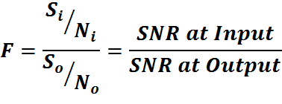
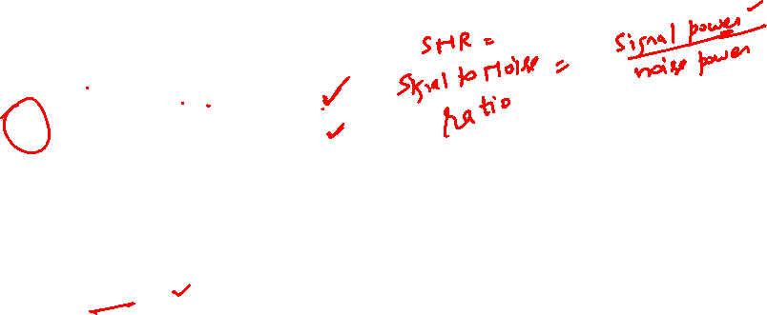
Introduction To Communication contd.
Module – V Vol. No.-1
Noise-Figure (F) is the measure of the noise-performance of a system-equipment such as transmitter or receiver. It is defined as:
[Eq.5.1.1]
In order to appropriately retrieve the signal, the Noise-figure must be always greater than ONE.

Slide 14
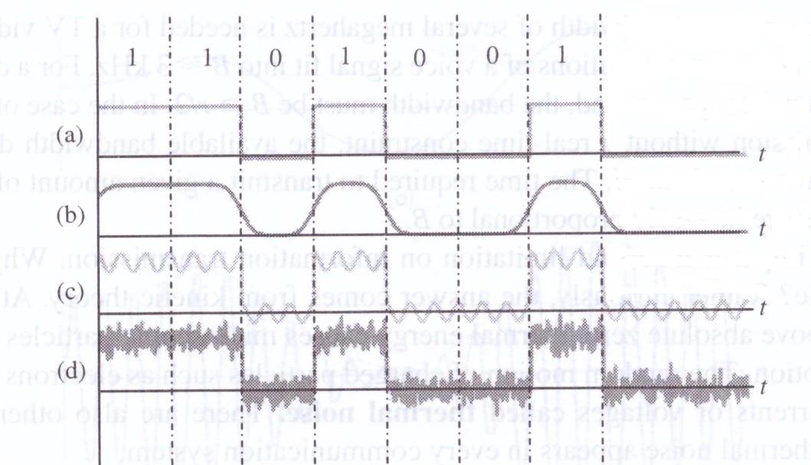

Introduction To Communication contd.
Module – V Vol. No.-1
Exa: Contamination of a signal transmitting a sequence [1101001]
Fig.5.1.3 [(a) original signal as it leaves the transmitter,
(b) effects of distortion, (c) effects of interference, (d) effects of noise]

Slide 15

Introduction To Communication contd.
Module – V Vol. No.-1
Major Design Parameters of Communication System:
There are four major design aspects which an engineer should take care in the design of an electrical communication system:
The bandwidth of the signal and communication channel.
The data rate that is used for digital data information.
The amount of noise and other impairments.
The level of acceptable error rate.
All these design aspects are interrelated.

Slide 16
Introduction To Communication contd.
Module – V Vol. No.-1
Primary Communication Resources:
In a communication system, two primary resources are employed:
Transmitted power: is the average power of the
transmitted signal.
Channel bandwidth: is the band of frequencies allocated
for the transmission of message signal.

Slide 17

Introduction To Communication contd.
Module – V Vol. No.-1
Types of Information Sources:
Based on the nature of the output signal, information sources can be categorized as :
Analog Information Sources: generates one or more continuously varying amplitude signals as function of time.
Example: microphone actuated by speech, or a video camera scanning the pictures.
Discrete Information Sources: generates a sequence of discrete values/symbols.
Example: digital binary output of a computer or a teletype signal.

Slide 18

Introduction To Communication contd.
Module – V Vol. No.-1
Types of Communication Channels:
Depending on the mode of transmission used, we may distinguish two
basic groups of communication channels.
Guided Propagation Channels:
Telephone channels
Coaxial cables
Optical fibers
Free propagation Channels:
Wireless broadcast channels
Mobile radio channels
Satellite channels.

Slide 19
Introduction To Communication contd.
Module – V Vol. No.-1
Radio Frequency (RF) Spectrum Bands & its Applications
Band Designation | Frequency Range | Free-Space Wavelength Range | Typical Application
ELF (Extremely Low Frequency ) | 30 Hz – 300 Hz | 10,000 Km – 1000 Km | Power line communication
VF (Voice Frequency) | 300 Hz – 3000 Hz | 1000 Km – 100 Km | Telephone system for analog subscriber lines
VLF (Very Low Frequency | 3 KHz – 30 KHz | 100 Km – 10 Km | Long-range navigation; Submarine communication
LF (Low Frequency) | 30 KHz – 300 KHz | 10 Km – 1 Km | Long-range navigation; Submarine communication radio beacons

Slide 20
Module – V Vol. No.-1
Introduction To Communication contd.
Band Designation | Frequency Range | Free-Space Wavelength Range | Typical Application
MF (Medium Frequency) | 300 KHz – 3000 KHz | 1000 m – 100 m | AM broad casting; Marine radio; Direction finding radio
HF (High Frequency) | 3 MHz – 30 MHz | 100 m – 10 m | Long-distance aircraft and ship communication; Military communication; Amateur radio
VHF (Very High Frequency) | 30 MHz – 300 MHz | 10 m – 1 m | FM broadcasting; Two-way radio; VHF television; Aircraft navigation aids
UHF (Ultra High Frequency) | 300 MHz – 3000 MHz | 100 cm – 10 cm | UHF-television; Cellular mobile telephone; Microwave links; Radar personal communication systems (PCS)

Slide 21
Module – IV Vol. No.-1
Introduction To Communication contd.
Band Designation | Frequency Range | Free-Space Wavelength Range | Typical Application
SHF (Super High Frequency) | 3 GHz – 30 GHz | 10 cm – 1 cm | Wireless local loop; Satellite communication; Radar: Terrestrial microwave links
EHF (Extremely High Frequency) | 30 GHz – 300 GHz | 10 mm – 1 mm | Wireless local loop; Specialized laboratory experiments
Infrared Light | 300 GHz – 300 THz | 1 mm – 1000 nm | Infrared LANs; Consumer electronic applications; Astronomy
Visible Light | 400 THz – 750 THz | 0.75 micron – 0.40 micron | Optical communication
Electromagnetic signals higher than 300 GHz are not called Radio-Waves; these are called Rays (X-rays, Cosmic-rays, etc.)

Slide 22
Introduction To Communication contd.
Module – V Vol. No.-1
Classification of Communication Channels:
We may classify communication channels in different ways:
Linear or Nonlinear:
A wireless radio channel is linear, whereas a satellite channel is usually (but not always) nonlinear.
Time invariant or Time varying:
An optical fiber is time invariant, whereas a mobile radio channel is typically time varying.
Bandwidth limited or Power limited:
A telephone channel is bandwidth limited, whereas an optical fiber link and a satellite channel are both power limited.

Slide 23
Introduction To Communication contd.
Module – V Vol. No.-1
A communication channel is central to a
communication system. Its properties determine both the Information-carrying capacity of the system and the Quality of service offered by the system.

Slide 24
Introduction To Communication contd.
Module – V Vol. No.-1
Fundamental Limitations of Communication System:
The fundamental limitations of information transmission by electrical means are:
Bandwidth
Noise

Slide 25

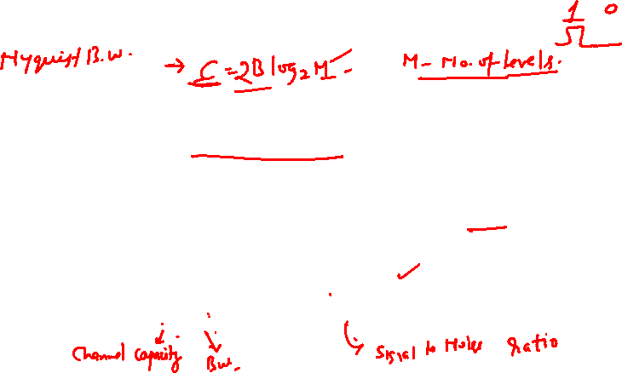
Introduction To Communication contd.
Module – V Vol. No.-1
Bandwidth Limitation: Communication under real-time conditions requires sufficient transmission bandwidth to accommodate the signal spectrum: otherwise sever distortion will result. Thus, every communication system has a finite bandwidth ‘B’ that limits the rate of signal variations.
Noise Limitation: Noise imposes a limitation on transmission. Thermal noise appears in every communication system. At lower
value of S/N, how ever noise degrades fidelity in
in
analog digital
communication and produce errors
communication.
SHANNON accounted both with
[Eq.5.1.2]

Slide 26

Introduction To Communication contd.
Module – V Vol. No.-1
Signal Bandwidth:
Most of the electromagnetic energy of an analog signal is contained in a relatively narrow band of frequencies referred to as effective-bandwidth or simply signal bandwidth.
In general, bandwidth gives important information about the signal in its frequency domain.

Slide 27

Introduction To Communication contd.
Module – V Vol. No.-1
The term Bandwidth is used in three distinct ways:
To characterize the information signal (signal bandwidth) as well as the transmitted baseband or broadband signal (transmitted bandwidth).
To design transmitter and receiver system. The frequency response of transmitter must be such that the total system bandwidth must support the channel bandwidth.
To allocate a channel to the user to allow the transmission of maximum frequency content i.e., channel bandwidth. It decides the transmission capacity.

Slide 28

Introduction To Communication contd.
Module – V Vol. No.-1
Channel Bandwidth:
The channel bandwidth defines the range of frequencies that it can handle for the transmission of baseband or passband signals with acceptable quality.
If the channel bandwidth does not match the frequency spectrum of the signal, some of the frequency components of that signal may be highly attenuated and not received.
For a prescribed frequency band of an information signal, the channel bandwidth also determines the number of such information signals that can be multiplexed over the channel.

Slide 29
Introduction To Communication contd.
Module – V Vol. No.-1
Performance Assessment of Communication System:
For the assessment of performance of a communication system, the
most commonly used criteria are:
Degree of Fidelity
Bandwidth Efficiency
System Complexity

Slide 30

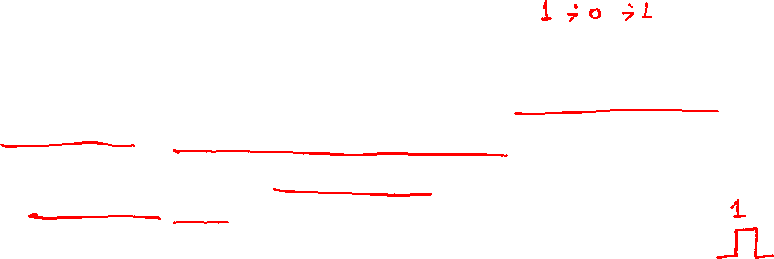
Introduction To Communication contd.
Module – V Vol. No.-1
Degree of Fidelity:
The degree of fidelity is the performance criterion that accesses the ability of an analog communication system to produce the desired signal faithfully at the output of the demodulator.
In case of a digital communication system, the performance criterion
is bit-error-rate (BER) or the probability of error (Pe).
The most widely used method of measuring the fidelity, specially in case where the output signal is in the form of the desired signal corrupted by additive noise is the signal-to-noise ratio (SNR) at the output of the demodulator.

Slide 31
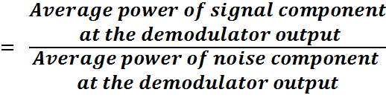



Introduction To Communication contd.
Module – V Vol. No.-1
SNR
[Eq.5.1.3]
Generally, Figure of Merit (FOM) is used as the performance index for any analog communication system.
[Eq.5.1.4]

Slide 32

Introduction To Communication contd.
Module – V Vol. No.-1
Bandwidth Efficiency:
Bandwidth Efficiency indicates, how well the system is utilizing the communication resource bandwidth and is defined as,
𝐵𝑎𝑛𝑑𝑤𝑖𝑑𝑡ℎ 𝑊
𝐸𝑓𝑓𝑖𝑐𝑖𝑒𝑛𝑐𝑦
𝐵𝑎𝑛𝑑𝑤𝑖𝑑𝑡ℎ 𝑜𝑓 𝐵𝑎𝑠𝑒𝑏𝑎𝑛𝑑 𝑆𝑖𝑔𝑛𝑎𝑙
⁼ 𝐵𝑎𝑛𝑑𝑤𝑖𝑑𝑡ℎ 𝑜𝑓 𝑇𝑟𝑎𝑛𝑠𝑚𝑖𝑡𝑡𝑒𝑑 𝑆𝑖𝑔𝑛𝑎𝑙
= _{𝐵}
𝐴𝑛𝑎𝑙𝑜𝑔
𝐶𝑜𝑚𝑚.
𝑇
[Eq.5.1.5]
The bandwidth efficiency of an analog-communication system
depends on the type of modulation employed.
Wide-band FM (WBFM) has the least bandwidth efficiency while the Single-band modulation scheme has the highest (100 %) bandwidth efficiency.

Slide 33

Introduction To Communication contd.
Module – V Vol. No.-1
The objective of a digital communication system is to transmit information at a fast rate as possible while maintaining the probability of error within the limits admissible for the specific application.
It must do this using minimum possible bandwidth and power by maintaining a high bandwidth efficiency and power efficiency.
Since a high rate of transmission requires a large bandwidth,
bandwidth efficiency is defined as the bit-rate per unit bandwidth,
𝐵𝑎𝑛𝑑𝑤𝑖𝑑𝑡ℎ
𝐸𝑓𝑓𝑖𝑐𝑖𝑒𝑛𝑐𝑦
𝑅_{𝐵}
Where;
R_{b} – Bit error rate (bits/sec)
=
[Eq.5.1.6]
𝐷𝑖𝑔𝑖𝑡𝑎𝑙
𝐶𝑜𝑚𝑚.
𝐵_{𝑇}
B – Transmission bandwidth
T
(Hertz)

Slide 34

Communication System Classification
Types of Communication Systems:
Communication systems can be classified based on their physical
infrastructure and the specifications of signals they transmit.
Based on physical infrastructure: There are two types of communication systems based on physical structures.
Line Communication
Wireless or Radio Communication
Based on Signal Specification: communication systems based on signal specification are:
Baseband Communication Systems
Carrier Communication Systems
Analog Communication Systems
Digital Communication System

Slide 35

Communication System Classification
Based on physical infrastructure:
Line Communication: In line communication, the channel employed will be a pair of conductors (transmission line) or single wire transmission channels (waveguide) or optical fiber.
Wireless or Radio Communication: In wireless or radio communication, a message is transmitted through open space (free space communication) using electromagnetic waves (radio waves). Radio waves are radiated from the transmitter through an antenna system into free space. The transmitted electromagnetic waves are intercepted by a receiving antenna at the receiver.
As compared to Wire-line-communications, Wireless-communications have advantages of cost effectiveness, simplicity, and long-distance communication possibility.

Slide 36

Communication System Classification contd.
Based on Signal Specification:
Baseband Communication Systems: are
those in which a low
frequency signal (message signal/modulating signal) is transmitted without a high frequency signal (carrier signal).
Exa: Wired communication systems in which the transmitter and receiver are directly connected to each other as in line communication.
Carrier Communication Systems: are those in which the message signal (modulating signal) gets modulated by a carrier signal and then transmitted generally over a wireless medium.
Exa: Radio communication, mobile communication, satellite
communication, etc.

Slide 37

Communication System Classification contd.
Analog Communication Systems: is the communication system in which the signal to be transmitted is in analog-form and the received signal is also in analog form.
Analog signals are sent between a transmitter and receiver over some form of transmission medium (wired or wireless) after modulation in order to avoid signal attenuation that limits the distance between transmitter and receiver.
The reverse process where the received signal is transferred back to its original form is called demodulation.

Slide 38

Communication System Classification contd.
Digital Communication System: is a communication system in which the signal to be transmitted is in digital form or may be an encoded analog signal.
Digital signals can be propagated through a limited distance only, otherwise higher signal attenuation can introduce unacceptable errors.
A large distance transmission is possible, only if at appropriate intervals, digital repeaters are used in digital transmission system to minimize the signal attenuation and distortion i.e., channel noise is not cumulative.

Slide 39
Modes of Communication
Mode of Communication:
Essentially, there are Three distinct modes of transmission for any communication link.
Simplex Mode of Communication
Half-duplex Mode of Communication
Full-duplex Mode of Communication

Slide 40

Modes of Communication contd.
Simplex Mode of Communication:
In simplex mode of communication, the information can be sent in only one direction.
Examples: ▪ AM/FM Broadcast Radio
TV broadcasting
Cable TV
Pager and Radio Astronomy
Half Duplex Mode of Communication:
In half-duplex mode of communication, the information can be sent in
both directions but in one direction only at a time.
Examples:
Walkie-talkie radio sets used by police and para-military services.

Slide 41

Modes of Communication contd.
Full Duplex Mode of Communication:
In full-duplex mode of communication, the information can be sent in both directions simultaneously sharing the common communication channel.
Landline telephone calls
Two-way radio
Cellular communication links
Radar
Satellite
Data communication
LANs
Examples:

Slide 42

Signal radiation and propagation
Introduction:
The interference between the transmitter and free space and between free space and the receiver is the antenna. At the transmitting end, the antenna converts the transmitter RF power into electromagnetic signal; at the receiving end, the antenna picks up the electromagnetic signals and converts them into signals for the receiver.

Slide 43

Signal radiation and propagation contd.
Radio Waves:
A radio signal is called an electromagnetic wave because it is made
up of both electric and magnetic fields.
These fields are emitted from the antenna and propagate through space at the speed of light.
Once a radio signal has been radiated by an antenna, it travels or propagates through space and ultimately reaches the receiving antenna.
The energy level of the signal decreases rapidly with distance from the
transmitting antenna.

Slide 44

Signal radiation and propagation contd.
Radio Wave Propagation:
In Radio communication systems, we use wireless
electromagnetic waves as the channel.
The antennas of different specifications can be used for these purposes.
The sizes of these antennas depend upon the bandwidth and
frequency of the signal to be transmitted.
The mode of propagation of electromagnetic waves in the
atmosphere and in free space may be divided in to the following three categories :
Ground wave propagation
Sky wave propagation
Space wave propagation

Slide 45
Introduction To Modulation
Modulation:
The process of changing one or more characteristics of the high frequency carrier signal in proportion with the instantaneous value of the analog(or digital) signal.
The low frequency information signal (modulating signal) is superimposed over a high frequency carrier signal in the process of modulation.
Modulation translates a low-frequency signal to the pass band of communication channel.
We generally require that modulation be a reversible operation, so the message can be retrieved by the complementary process of demodulation.

Slide 46
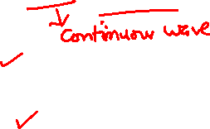
Introduction To Modulation contd.
Classification of Modulation Techniques:
Modulation Technique can be broadly classified into three categories as follows.
Analog Modulation / CW-Modulation
Pulse Modulation
Digital Modulation

Slide 47

Introduction To Modulation contd.
Analog Modulation / CW-modulation:
When the modulating signal as well as the carrier signal is analog in nature, the process of modulation is called analog modulation. It is also called continuous wave(CW) modulation.
Analog modulation technique involves the modulation of time varying sinusoidal carrier signal by analog information signal.
The different analog modulation techniques are:
Amplitude Modulation (AM)
Frequency Modulation (FM)
Angle Modulation
Phase Modulation (PM)
These corresponds to variation of amplitude, frequency or phase of the carrier signal in proportion to the instantaneous value of the analog modulating signal.

Slide 48
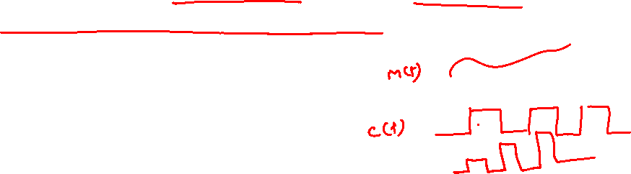
Introduction To Modulation contd.
Pulse Modulation:
When the modulating signal is analog in nature and the carrier signal is a periodic sequence of rectangular pulse waveform, the process of modulation is known as Pulse Modulation.
The different Pulse modulation techniques are:
Pulse Amplitude Modulation (PAM)
Pulse Width Modulation (PWM)
Pulse Position Modulation (PPM)
These correspond to variation of amplitude, width or relative position of the carrier pulse signal in proportion to the instantaneous value of the analog modulating signal.
The digital form of pulse modulation(encoding of pulse amplitude modulation waveform by digital codes) is known as pulse code modulation (PCM).
[16]

Slide 49
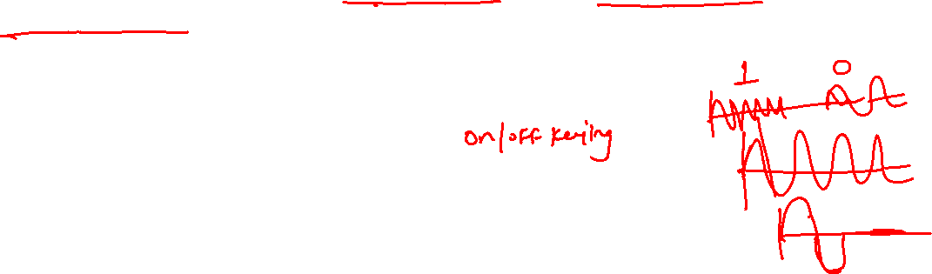
Introduction To Modulation contd.
Module – V
Vol. No.-2
Digital Modulation:
When the modulating signal is digital in nature and the carrier signal is analog in nature, the process of modulation is known as digital modulation.
The different digital modulation techniques are:
Amplitude Shift Keying (ASK)
Frequency Shift Keying (FSK)
Phase Shift Keying (PSK)
These corresponds to variation amplitude, frequency or phase of the
carrier signal in proportion to the digital modulating signal.
When the amplitude and phase of the analog carrier signal are varied together in proportion to the digital modulating signal, it is known as Quadrature Amplitude Modulation (QAM).

Slide 50
Introduction To Modulation contd.
Module – V
Vol. No.-2
Different Modulation Techniques
Type of | Modulating | Carrier | Parameter of Carrier | Modulation
Modulation | or | Signal | Signal Which is varied | Type
Technique | Information |  | in proportion to
 | Signal |  | Information Signal
Analog | Analog | Analog | Amplitude | AM
 |  |  | Frequency | FM
 |  |  | Phase | PM
Pulse | Analog | Digital | Amplitude | PAM
 |  |  | Width | PWM
 |  |  | Position | PPM
Digital | Digital | Analog | Amplitude | ASK
 |  |  | Frequency | FSK
 |  |  | Phase | PSK
 |  |  | Amplitude & Phase | QAM

Slide 51

Introduction To Modulation contd.
Module – V
Vol. No.-2
Modulation Benefits:
The primary purpose of modulation in a communication system is to generate a modulated signal to the characteristics of the transmission channel. There are several practical benefits and applications of modulation as follows:
Efficient transmission
To overcome hardware limitations
Frequency translation
Multiplexing
Reduction of noise and interference

Slide 52

Introduction To Modulation contd.
Module – V
Vol. No.-2
Modulation for Efficient Transmission:
Signal transmission over appreciable distance always involves a travelling electromagnetic wave.
The efficiency of any transmission method depends upon the frequency of the signal being transmitted.
By exploiting the frequency-translation property of CW-modulation, message information can be impressed on a carrier whose frequency has been selected for the desired transmission method.
In a wireless communication channel, quarter-wavelength (λ/4) antennas are employed for efficient transmission and reception.

Slide 53





Introduction To Modulation contd.
Module – V
Vol. No.-2
An estimate of antenna height required at different frequencies of transmission is calculated as follows:
Signal Frequency | Value of ( λ) | Value of ( λ/4)
1 KHz |  | 75 Km
15 KHz |  | 1,250 m
1 MHz |  | 75 m
1000 MHz |  | 75 mm
As shown above, the solution lies in translating (or modulating) low- frequency information signals to a higher-frequency carrier
signals allowing the practical length of antennas to be used.

Slide 54

Introduction To Modulation contd.
Module – V
Vol. No.-2
Modulation to overcome Hardware Limitations:
The design of a communication system may be constrained by the cost and availability of hardware, hardware whose performance often depends upon the frequencies involved.
Modulation permits the designer to place a signal in some frequency range that avoids hardware limitations.
The hardware cost and complications are minimized if the fractional – bandwidth (absolute bandwidth divided by the center frequency) is kept within1-10 percent.
For instance, a 5 GHz microwave system can accommodate 10,000 times as much as information in a given time interval as a 500 KHz radio channel.
Going even higher in the electromagnetic spectrum, one optical laser beam has a bandwidth potential equivalent to 10 million TV channels.

Slide 55
Introduction To Modulation contd.
Module – V
Vol. No.-2
Modulation for Frequency translation:
When we tune a radio or television set to a particular station, we select one of the many signals being received at that time.
Since each station has a different assigned carrier frequency, the desired signal can be separated from the other by filtering.
Modulation enables one to translate the signals occupying similar frequency ranges to different regions in the frequency spectrum.
In the absence of modulation schemes the signals from various
stations would have resulted in a jumble of interfering signals.

Slide 56
Introduction To Modulation contd.
Module – V
Vol. No.-2
Modulation for Multiplexing:
Multiplexing is the process of combining several signals for
simultaneous transmission on one channel.
Sometimes it is necessary to send several signals between two points.
simultaneously
Frequency division multiplexing (FDM) uses CW-modulation to put each signal on a different carrier frequency.
A bank of filters separates the signals at the destination.
Time division multiplexing (TDM) uses pulse modulation to put
samples of different signals in non-overlapping time slots.
Therefore, we can say that multiplexing provides another way of increasing communication efficiency.

Slide 57

Introduction To Modulation contd.
Module – V
Vol. No.-2
Modulation to reduce Noise and Interference:
Noise and interference are two major limitations of any communication system.
These effects can not be eliminated totally but can be suppressed to some extent.
FM and certain types of modulation have the valuable property of suppressing both noise and interference.
This property is called wideband noise reduction because it requires the transmission bandwidth to be much greater than the bandwidth of the modulating signal.

Slide 58
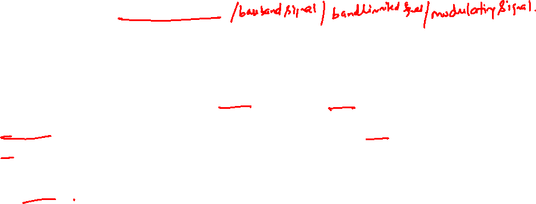
Baseband Signal & Baseband Communication
Baseband Signal:
The term baseband is used to represent the frequency band of the original information or message signal.
The frequencies occupied by baseband signals extend to (or close to) zero (d.c.).
The baseband signal may be both analog as well as digital.
The analog baseband signal vary continuously with amplitude and time.
The digital baseband signal are discrete in both amplitude and time.

Slide 59

Baseband Signal & Baseband Communication
Contd.
Baseband Communication:
When the baseband signals are directly transmitted using dedicated communication channel such as twisted pair of copper wires or coaxial cables, it is referred to as baseband communication.
Transmitting the baseband signals directly require a dedicated communication channel as in the case of individual telephone line communication.
Generally, the baseband transmission is preferred at low frequencies.
The baseband communication is suitable for short distances between a source and the destination.

Slide 60

Baseband Signal & Baseband Communication
Contd.
Module – V Vol. No.-2
Limitations of Baseband Communication:
The baseband communication is highly inefficient due to unused channel-spectrum of the transmitting medium.
It is not suitable for transmission over the free space due to
impractical antenna dimensions for large distances.
Simultaneous transmission of many baseband signals over a common channel will result into inseparable mixing up of signals, leading to unintelligible reception.
Mobile communication is almost impossible with a wireline baseband transmission system and difficult with a wireless baseband communication system.

Slide 61
Bandpass Signal & Bandpass Communication
Module – V Vol. No.-2
Bandpass Signal & Bandpass Communication:
If the low-frequency baseband signal is impressed upon a fixed high- frequency analog carrier signal, the passband signal or bandpass signal is produced.
The bandpass transmission is generally used at high frequency spectrum.
It finds application for long distance communication such as audio and television broadcast, microwave and radar communications, satellite transmission etc.
The electronic communication using modulation to shift the frequency spectrum of baseband signal to higher frequency spectrum is called as Bandpass Communication or Carrier Communication.

Slide 62
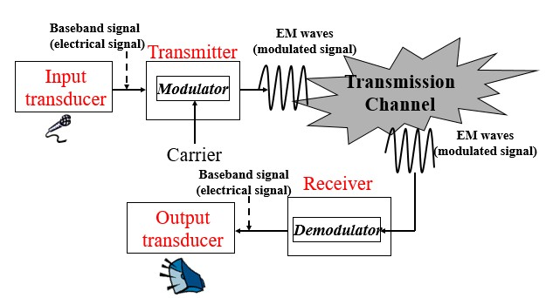
Module – V Vol. No.-2
Basic Analog Communications System
Fig.5.2.5 [A basic Analog communication system]

Slide 63
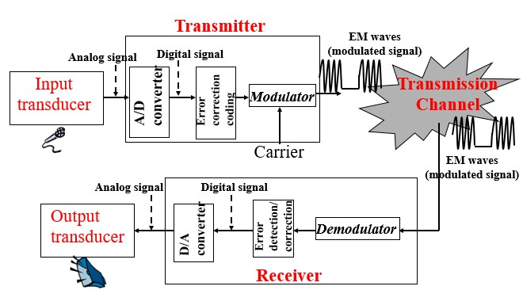
Module – V Vol. No.-2
Basic Digital Communications System
Fig.5.2.6 [A basic Digital communication system]

Slide 64
Module – V
Vol. No.-2
A Brief Comparison
Analog Communication System | Digital Communication System
Advantages: Smaller bandwidth Synchronization problem is relatively easier | Advantages: Inexpensive digital circuits Privacy preserved(data encryption) Can merge different data (voice, video, and data) and transmit over a common digital transmission system error correction by coding
Disadvantages: Expensive analog components No privacy Cannot merge data from different sources No error correction capability | Disadvantages: Larger bandwidth Synchronization problem is relatively difficult

Slide 65




Module – V
Vol. No.-2
An analog communication system should deliver the signal with a specified degree of Fidelity.
&
A digital communication system should deliver data with a specified degree of Accuracy in a specified amount of time.

